Slide 1
ToDo: value stream maps

Slide 2
'The Phoenix Project' & 'The Goal’
Lessons learned from
@LlewellynFalco

Slide 3

https://lfal.co/PhoenixGoal

Slide 4

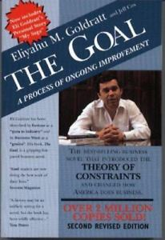
&
Bill, VP of IT Operations
Alex the plant manager

Slide 5

Promotion
TROUBLE
MENTOR
Start
Not enough
SALES
Success
Bill
Alex
Promotion
TROUBLE
MENTOR
Start
Not enough
SALES
Success

Slide 6
Success

Slide 7
“Movement is not Work ” - Taiichi Ohno

Slide 8
What the Goal got to do with me?

Slide 9
This IS me

Slide 10
Visualize the Work

Slide 11
Value Stream

Slide 12
Kanban

Slide 13
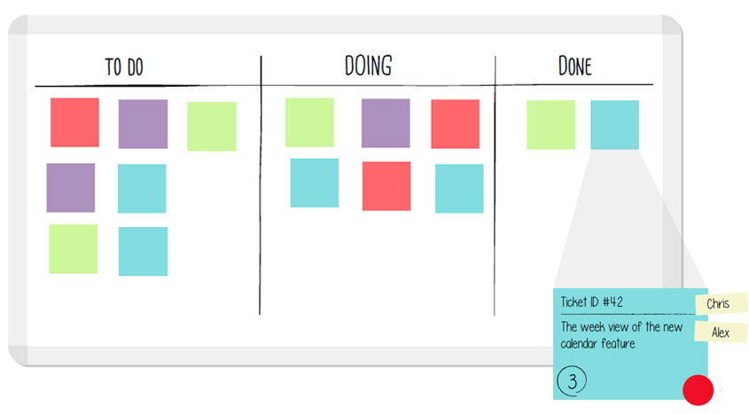
Kanban

Slide 14
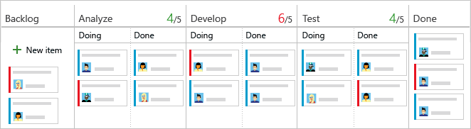

Slide 16
Optimize for Change in your visualization

Slide 17

What is Work?

Slide 18
BottleNeck

Slide 19






Chapter 13 – The Goal

Slide 23
Theory of constraints

Slide 24
Brent works for wes. He’s always in the middle of the important projects
that IT is working on. I’ve worked with him many times. He’s definitely
a smart guy but can be intimidating because of how much he
knows. What makes it worse is that he’s right most of the time
Brent

Slide 25
The Goal Money
=

Slide 26
Inventory
Throughput
Costs

Slide 27
Alex – “Robots increased productivity by 36% in one department”
Jonah – “Are plant inventories down?” : No
“Is employee expense less?” : No
“Shipping more product?”: No
Alex – “…but we must keep robots running to maintain efficiencies”
Jonah – “Then inventories must be sky high
and orders must be late.”

Slide 28
any improvement
not made at the constraint is just an illusion

Slide 29
5 Focusing STEPS
IDENTIFY the system's constraint.
EXPLOIT the constraint.
SUBORDINATE everything else to the constraint.
ELEVATE the constraint.
PREVENT INERTIA from becoming the constraint!

Slide 30

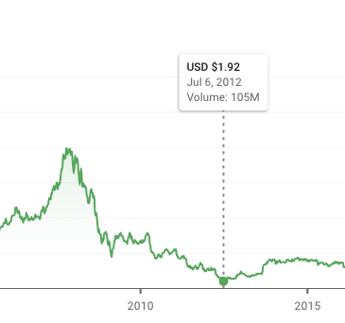
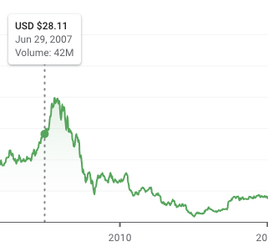
iPhone

Slide 31
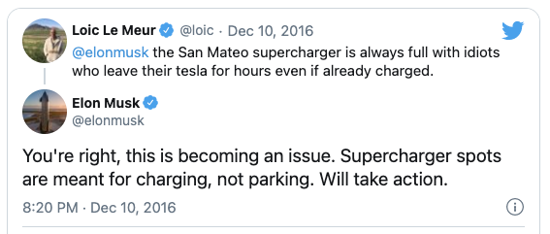
Saturday
LEAD Time
* https://www.inc.com/justin-bariso/elon-musk-takes-customer-complaint-on-twitter-from-idea-to-execution-in-6-days.html

Slide 32
FLOW
vs.
utilization

Slide 33
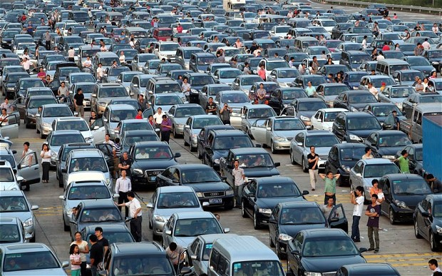
FLOW

Slide 34


Slide 35
The Goal
Alex’s First Chance to Test the Boy Scout Theory
Expectation:
Hourly Part Count
Fabrication
(25/hour)
Transfer
(once/hour)
Weld
(25/hour)
 | noon | 1:00 | 2:00 | 3:00 | 4:00
Fabrication | 25 | 25 | 25 | 25
Welding |  | 25 | 25 | 25 | 25

Slide 36
The Goal
Alex’s First Chance to Test the Boy Scout Theory
Realization:
100
90
Hourly Part Count
Fabrication
(25/hour)
Transfer
(once/hour)
Weld
(25/hour)
 | noon | 1:00 | 2:00 | 3:00 | 4:00
Fabrication | 19 | 21 | 28 | 32
Welding |  | 19 | 21 | 25 | 25

Slide 37
Sales
Notes:
Goal, still not good enough, get sales they were going to throw away because they couldn’t do it. 1000 pieces in 2 weeks -> 250 a week for 4 weeks.
$700 -> $600 because spare capacity

Slide 38
Random Bits
Notes:
Goal, still not good enough, get sales they were going to throw away because they couldn’t do it. 1000 pieces in 2 weeks -> 250 a week for 4 weeks.
$700 -> $600 because spare capacity

Slide 39
4 types of Work
Business
Internal
Operations
Unplanned

Slide 40
System Thinking
Feedback
Experimentation
3 ways

Slide 41
“INFOSEC WINS WHEN IT REMOVES WORK FROM IT”

Slide 42
MILITARY, Chemical Engineer, Auditors

Slide 43
“IMPROVING DAILY WORK IS EVEN MORE IMPORTANT THAN DOING DAILY WORK”

Slide 44
1.00³⁶⁵ = 1 1.01³⁶⁵ = 37.78

Slide 45
“Repetition creates habits, and habits are what creates mastery”

Slide 46

Contact Information
https://lfal.co/PhoenixGoal
@LlewellynFalco http://LlewellynFalco.Blogspot.com
http://www.approvaltests.com
Notes:
Both

